Slide 1
Data Management and Statistics. Day 1: Data Management
Jon Minton
Caroline Haig
Rachel Zhang

Slide 2
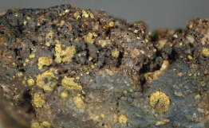

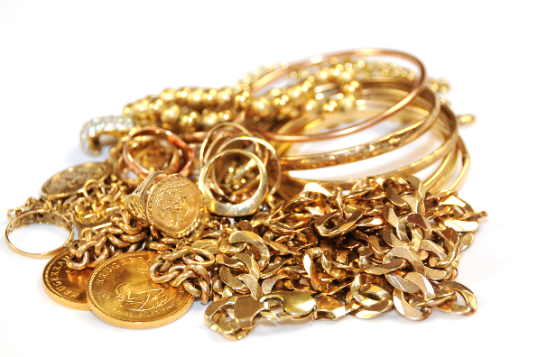
Aim of Day 1
Raw Data
Tidy Data
Statistical Analysis and Insight
http://www.thedailysheeple.com/700-tons-of-gold-ore-disappears-in-pacific-contact-with-transport-ship-lost_102012
http://www.eadt.co.uk/business/uk_high_street_pawnbroker_gold_bar_is_hit_by_fall_in_gold_prices_1_2332162
http://bluskyegroup.com/tag/gold-jewellery/

Slide 3
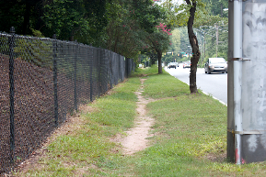
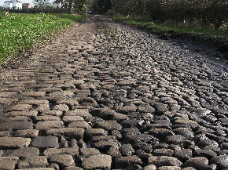

Approach in Day 1
Raw Data
Tidy Data
Dirt Roads
Reading through (Seeing)
Rocky Roads
Reasoning through (Questioning)
Smooth Roads
Thinking through (Understanding)
http://blog.historian4hire.net/2013/08/04/orthodox-desire-lines/
http://cycleclassics.co.uk/the-cycle-classics-roubaix-series/
http://www.tarmac123.co.uk/tarmac-roads.html

Slide 4
Summary ideas
Pinker’s ‘Gene for bread’
Many components to good data management
Each has to be covered to at least some extent (dirt roads)
But we hope to add depth as well as breadth where possible (rocky roads)
Full understanding only comes from repeated work (smooth roads) and unlikely to be achieved by the end of the day.
Handbook is a guide for today but also for coming weeks and months
Ask me questions throughout (as long as we keep on track);
Ask me questions afterwards: jonathan.minton@glasgow.ac.uk
Good luck!

